Slide 1
Intro to Quant Finance
Brilliant.org

Slide 2
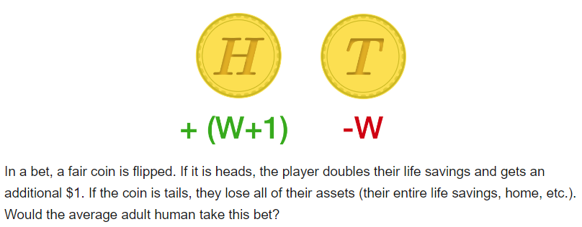
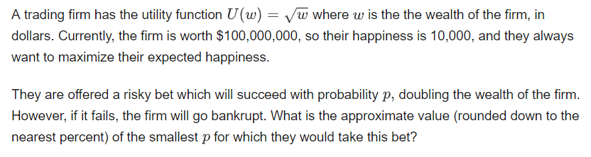


Financial Models
While financial “experts” can still provide insights and make key decisions, the new heroes are math, statistics, and computer science.
The massive amount of trading data – and the frequency at which trading occurs – is a major reason why quantitative methods and automated algorithms have become a bedrock of Wall Street. For example there are about 100 trades per second being executed on the NYSE during a normal trading day.
Under “normal” conditions (e.g. not around earnings reports), it is often reasonable to model a stock price as a random variable. With no information about a stock, multiplying or dividing the stock’s price by 1.001 each minute with equal probability is a fairly good model.
With any probabilistic model, the usefulness of the model is dependent on the validity of its underlying assumptions. For example, mortgage default are often correlated. Therefore, building a model based on uncorrelated default risk would be problematic. In such a construction, the model may severely underestimate the probability of mass default.
Expected value and risk must be considered together. For example, the bet shown below has a positive expected value of $0.50, however, this level of positive expectation would hardly incentivize anyone to take this bet.
One must consider an investor’s utility function (happiness versus wealth) when gauging risk versus reward tradeoffs.
Probability
Statistics
Correlation
Variance
Expected Value
Markov Chain
$$Expected Utility=\left(1−p\right)\sqrt{0}+p\sqrt{200M}=p\sqrt{2}\sqrt{100M}$$
Quantitative Financial Models
$$p\sqrt{2}\sqrt{100M}>\sqrt{100M}$$
$$p>\frac{1}{\sqrt{2}}=70.7\%$$

Slide 3
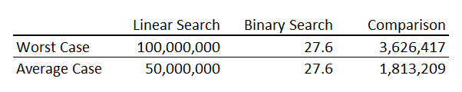
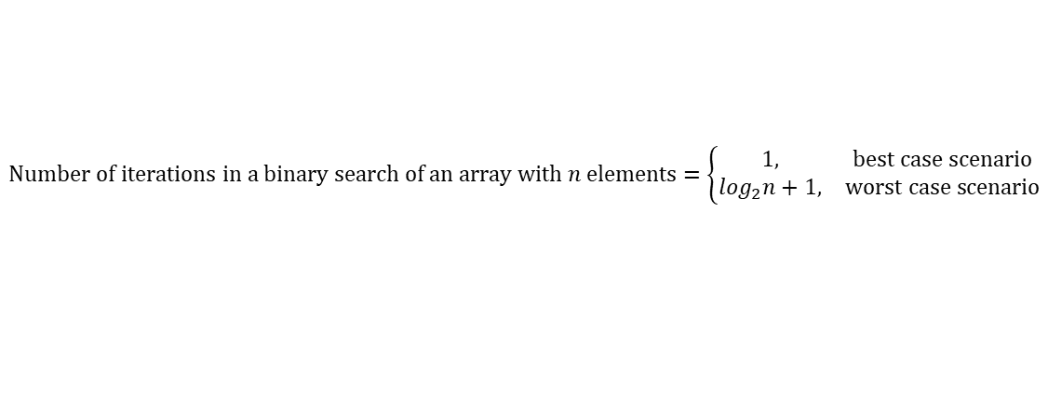
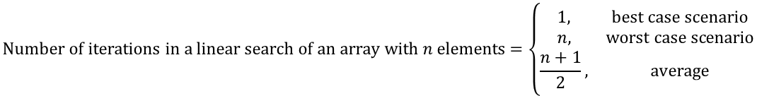
Searching
Set-up: suppose you have an unsorted array of 1000 elements and you want to check if a given value is in the array.
The naïve approach would involve iterating through the unsorted array to find a potential match and stopping the iteration if a match is found. The maximum number of iterations in this approach would equal the size of the array. This search algorithm is known as a linear search.
The problem with linear search is that the average iterations scale linearly with n. So if the size of an array increases exponentially, so does the average iterations.
Set-up: suppose you have a sorted array of 1000 elements and you want to check if a given value is in the array.
In a binary search algorithm we start at the midpoint of the array and implement a comparison operation. The comparison operation tells us whether the midpoint is greater than, less than, or equal to the search value. If the search value is greater than the midpoint, we move to the midpoint of the left half and implement the comparison operation on this half. We continue this process until we either find the match or determine that the search value is not in the array.
How much faster is a binary search (in the worst case scenario) on a sorted array than a linear search (in the worst and average case scenario) on the same array? For example, what is this comparison on a sorted array of 100 million elements?
$$Number of iterations in a linear search of an array with n elements=\left\{\begin{matrix}1, & best case scenario \\ n, & worst case scenario \\ \frac{n+1}{2}, & average\end{matrix}\right.$$
$$Number of iterations in a binary search of an array with n elements=\left\{\begin{matrix}1, & best case scenario \\ \log_{2}n+1, & worst case scenario\end{matrix}\right.$$

Slide 4

Insertion Sort
Sorted lists are generally more useful than unsorted lists. Therefore, the logical next question is how to sort a list.
The naïve method to sorting a list is called insertion sort.
Start with a sorted array A
Full Insertion Sort
This “full” algorithm splits the initial unsorted array, A, into two partitions: a sorted left side and an unsorted right side. The first step is to consider the left-most element as the initial left partition. The second element becomes the “x” in our insertion sort algorithm. When the first and second elements are sorted, the left partition now has two elements. The next iteration starts with the left-most element of the right partition becoming the new “x” that is put through the insertion sort algorithm against the left partition. This loop is repeated until there are no more elements remaining in the right partition.
The worst case scenario for the full insertion sort algorithm occurs when the initial array is in descending order and the objective of the full insertion sort is to place the elements in ascending order.
Insert a new element x into A
Place x at right end of A
$$\# interations in worst case scenario=\frac{n(n−1)}{2}$$
The full insertion sort scales by n². This is disastrous for large n.
The scale of average case scenario behaves like the worst case scenario.
Compare x to the element left of x
Swap position of x and element left of x
x is greater than or equal to element left of x
no element left of x
$$\# interations in best case scenario=n−1$$
END
The full insertion sort scales by n in the best case scenario. Therefore, even in the best case scenario the performance is bad for large n.

Slide 5
Big O Notation
In computer science and programming, we’re always looking for “good” solutions. In many cases, the good solution is the one which performs the fastest, which is generally related to using the fewest computations.
To meaningfully compare algorithmic performance, we can use big O notation – sometimes referred to as “order of growth”. Big O notation compares the asymptotic behavior of algorithms; that is, how does an algorithms performance scale as a function of the input size?

